Slide 1
Mixed ANOVA (GLM 5)
Prof. Andy Field

Slide 2
Aims
What is Mixed ANOVA?
Carrying out Mixed ANOVA on IBM SPSS
Interpretation
Main Effects
Interactions

Slide 3
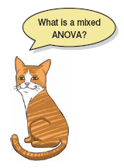
What is Three-Way Mixed ANOVA?
Three Independent Variables
Three-way = 3 IVs
Mixed:
1 or more Independent variable uses the same participants
1 or more Independent variable uses different participants
A.K.A. ‘Mixed-Plot Design’

Slide 4
An Example: Speed Dating
Is personality or looks more important?
IV 1 (Looks): Attractive, Average, Ugly
IV 2 (Personality): High Charisma, Some Charisma, Dullard
IV 3 (Gender): Male or Female?
Dependent Variable (DV): P’s rating of the date
100% = The prospective date was perfect!
0% = I’d rather date my own mother

Slide 6
Effects
Main effects
We will get an F-ratio for the main effect of each independent variable:
Looks
Personality
Gender
Two-Way Interactions
We will get F-ratios for all possible interactions between pairs of variables:
Looks × Personality
Looks × Gender
Personality × Gender
Three-Way Interactions
We will get an F-ratio for the interaction between all three variables
Looks × Personality × Gender

Slide 7
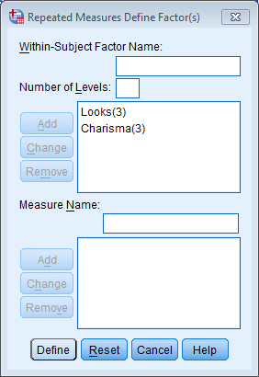
Define the Repeated Measures Variables

Slide 8
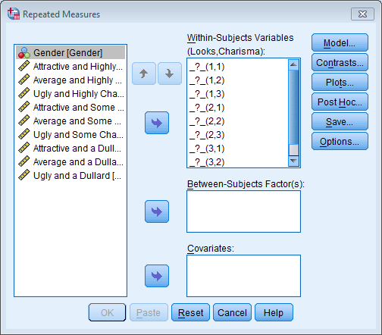
Define Levels of the Repeated Measures Variables

Slide 9
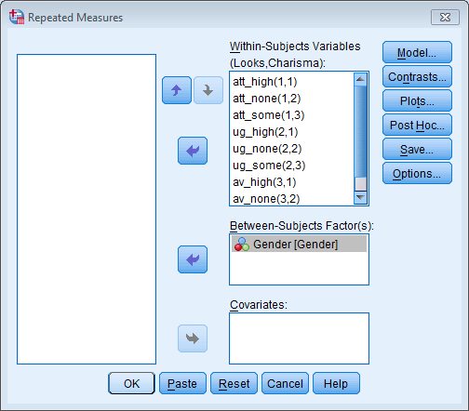
Define Levels of the Repeated Measures Variables and Select the Between-Group Variable

Slide 10
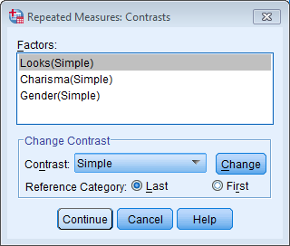
Define Contrasts

Slide 11
Define Interaction Graphs

Slide 12
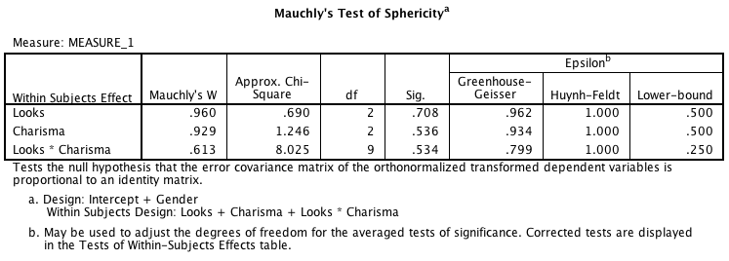
Output: Sphericity

Slide 13
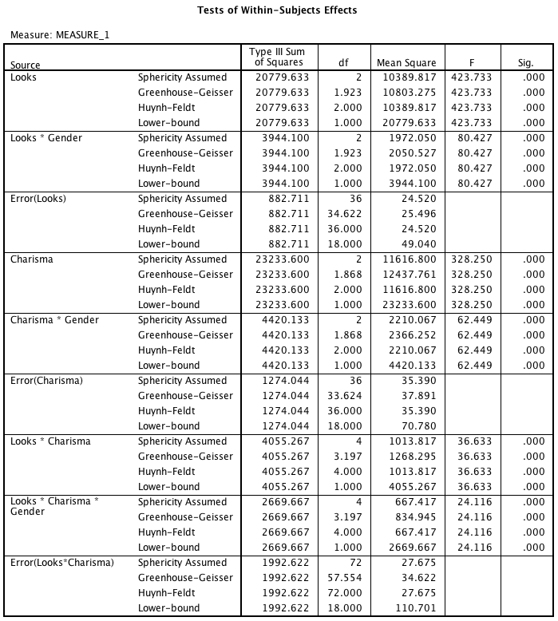
Repeated Measures Effects
Notes:
Note that I’ve collapsed the table across sphericity corrections so that you can actually read it

Slide 14
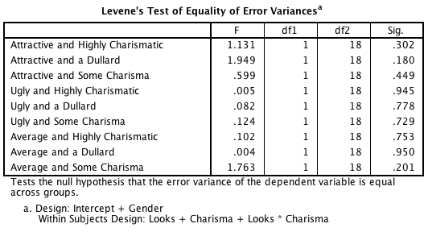
Homogeneity of Variance

Slide 15
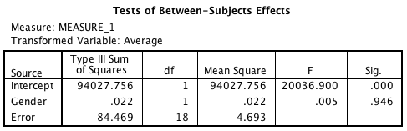
Between-Group Effects

Slide 16
Main Effect of Gender

Slide 17
Main Effect of Looks

Slide 18
Main Effect of Charisma

Slide 19
The Gender × Looks Interaction

Slide 20
Gender × Charisma Interaction

Slide 21
The Looks × Charisma Interaction

Slide 22
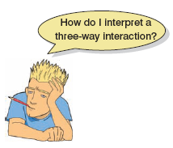

Slide 23
Gender × Looks × Charisma Interaction

